Slide 1

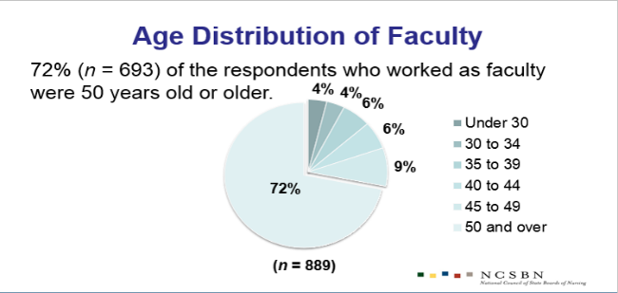
NCSBN & The Forum of State Nursing Workforce Centers
2015 National Workforce Survey of RNs
Background & Method
  Method
The Health Resources and Services Administration (HRSA) formally conducted the National Sample Survey of RNs.
The final survey was completed in 2008 (data reported out in 2010).
NCSBN & The Forum partnered to fill the ongoing need to collect data on the supply of RNs using the Minimum Dataset survey items with additional Compact and tele-health questions.
  Method
  Stratified random sample by state = 260,000 RNs
Respondents = 78,739
Response Rate = 30%
Tele-health Results
  31.5% indicated they engaged in telehealth between 1% and 25% of their time.
  Of respondents who indicated they utilized tele-health, 31.7% engaged in telehealth across state border between 1% and 25% of their time.
Employment Results
82% of respondents were actively employed in nursing
63% reported working full time
6% of respondents were unemployed
    About ½ of these were not seeking work as a nurse
Reasons for being unemployed:
    Taking care of home and family (50%)
    Difficulty in finding a nursing position (15%)
  Respondents with the following degrees had the highest rate of active employment in nursing:
    ADN (83%)
    BSN (85%)
    MSN (87%)
    DNP(97%)
    PhD (83%)
Nurse Faculty Results
Demographic Results
According to the US Census Bureau individuals from ethnic and racial minority groups accounted for 37.9% of the US population in 2014.
19.5% of the respondents were minorities – an increase from 17% in 2008.
Male RNs (8%) were better represented in the nursing workforce compared to 2013 results (7%).
Study respondents were predominantly female (92%).
Hours Worked Results
  The average number of hours worked during a typical week for RNs with one nursing position was 36.6 hours; for RNs with two or more positions 42.2 hours.
  In terms of average hours worked per week by highest level of education, respondents in the doctoral category worked 45.9 hours on average
  A response bias analysis showed that the following group of nurses may be slightly over-represented in our study sample who completed the survey
    White, female, 60 years or older
Nurse Faculty Education Results
Highest level of education:
    MSN (36%)
    DNP (5%)
    PhD Nursing (8%)
    Doctoral degree-nursing other (4%)
    Doctoral degree-other field (1%)
Age & Employment Results
  91% of nurses younger than age 50 are employed in nursing,
  In 2013, 47% of those aged 65 and older were employed in nursing, white in 2015 40% were employed in nursing
Limitations
Authors’ Notes
  Correspondence regarding this article should be addressed to
  Carey McCarthy at NCSBN, 111 E Wacker Dr, Ste 2900, Chicago, IL 60601. Electronic mail may be sent to research@ncsbn.org.

